Slide 1
old, expensive & traditional wines are (=!) the best
an analysis of wines and wine myths
by Sonja Matejina & Laura Wensley
Notes:
Lw – 20 sec

Slide 2
hypotheses
H1: Quality of wine depends on the year of its production.
The older the wine, the better it tastes.
H2: Price is a strong indicator of quality.
The more expensive the wine, the better it tastes.
H3: Old world wines are the gold standard.
Wines from France taste better.
Notes:
Lw – 40 sec

Slide 3
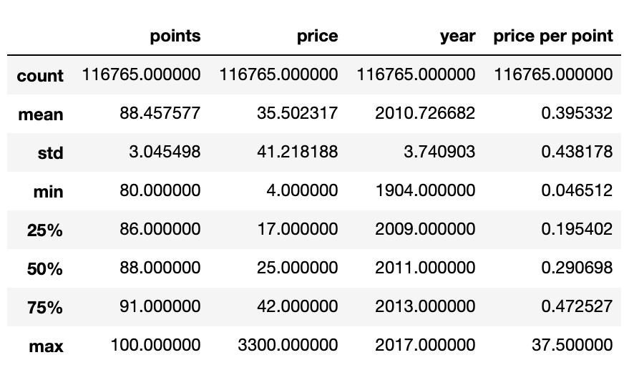
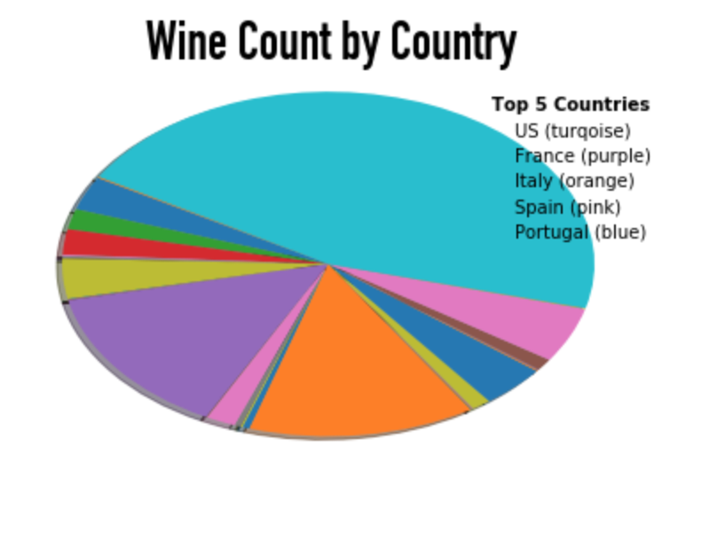
wine list data set
‘country’, ‘points’, 'price’ , ’province’,
‘title’, ‘variety’, ‘year’, ‘price bin’,
‘points bin’, ‘price per point'
Notes:
Lw -1 min

Slide 4
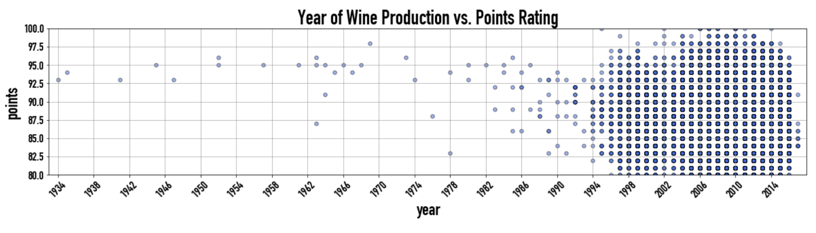
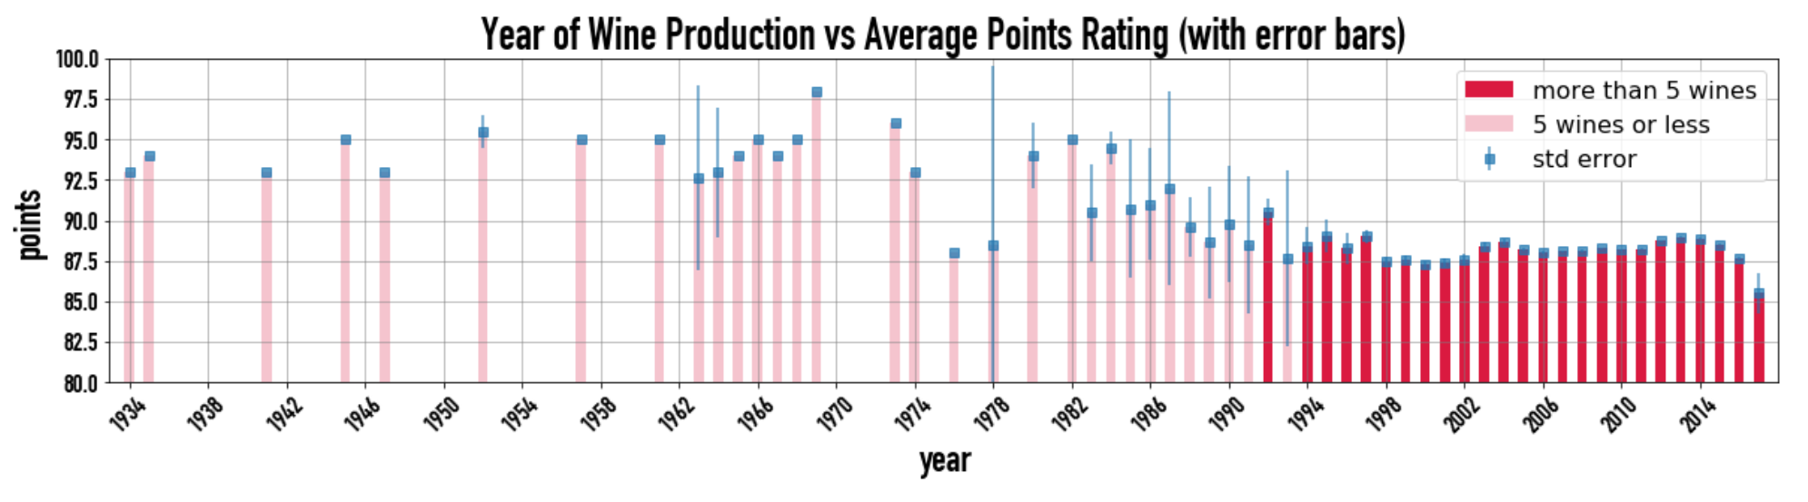
H1: the older, the better
Notes:
Sm – 1 min

Slide 5
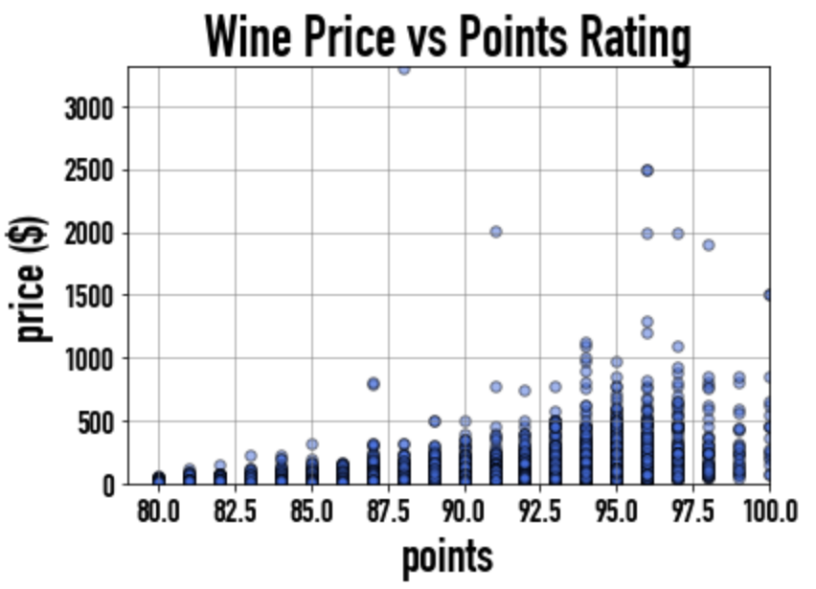
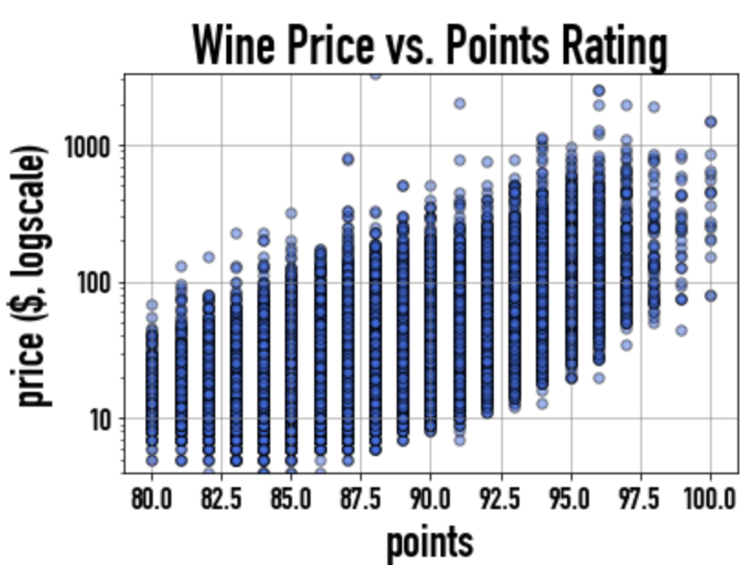
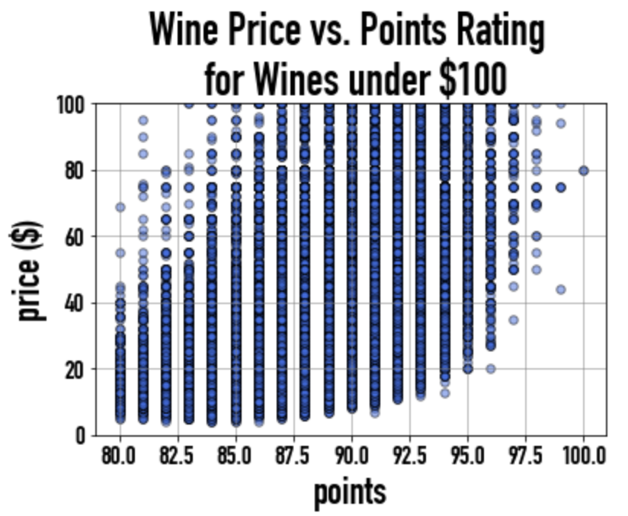
H2: the more expensive, the better
Notes:
Sm – 1 min

Slide 6
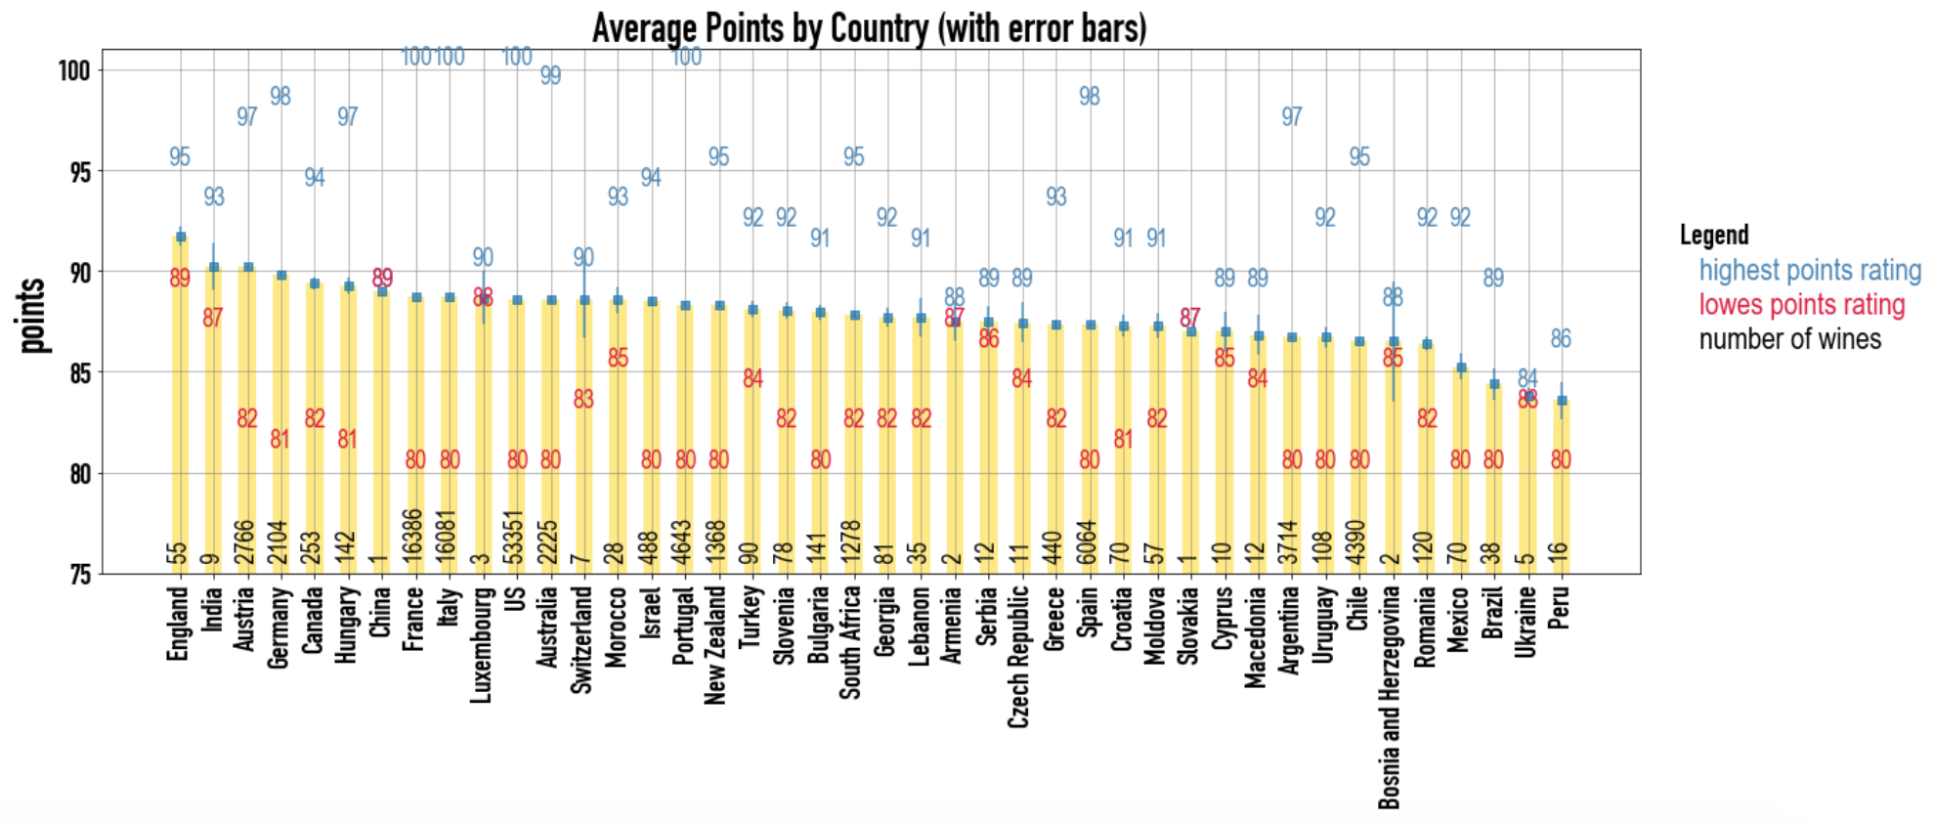
H3: better wines are from France
Notes:
Lw – 30 sec

Slide 7
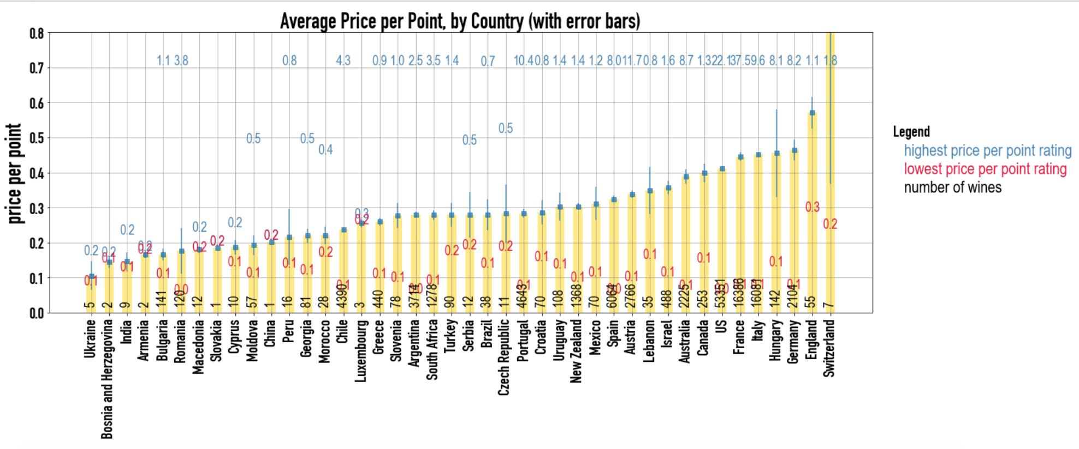
H3: better wines are from France
Notes:
Lw – 30 sec

Slide 8
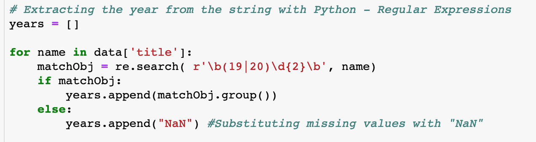
problems/solutions
Extracting number (year) from string using regular expression
Notes:
Sm – 1 min

Slide 9
Conclusion
Age does not mean quality
Price does not mean quality
Older wine are not more expensive
While the best wines do in fact come from the most notable wine countries -France, US, Italy and Portugal- English wines are actually better tasting on average; with the caveat that they are by far the most expensive by value.
Notes:
Lw – 30 sec

Slide 10
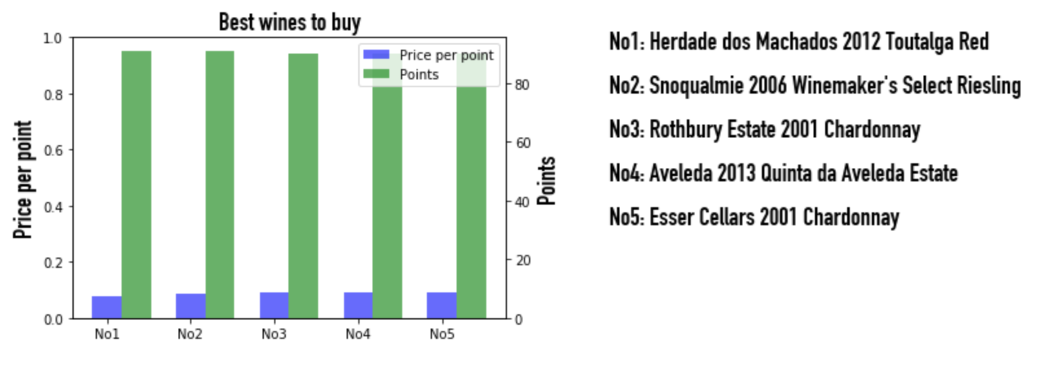
best value wines in the top 25%
Notes:
sm

Slide 11
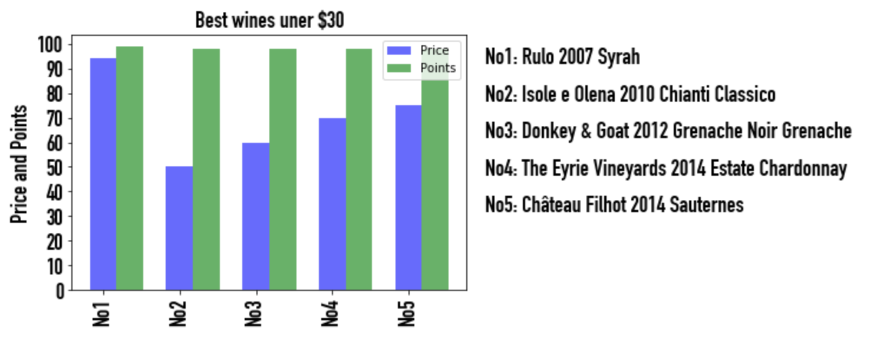
best wines under $30
Notes:
sm

Slide 12
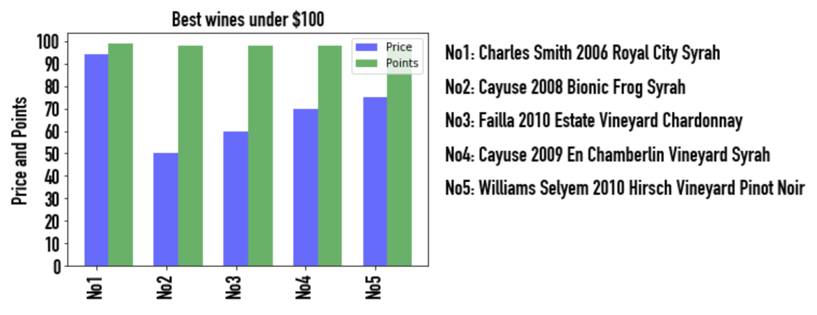
99- and 100-point wines under $100
Notes:
sm

Slide 13
Future Research
Do these trends still hold true for different varieties?
Do wineries in the same region have the same annual trends?
Is there a correlation between points and weather data?
Is there a “perfect weather pattern” to produce the best wine?
Do tasters have biases in their ratings?
Notes:
Lw -30 sec

Slide 14
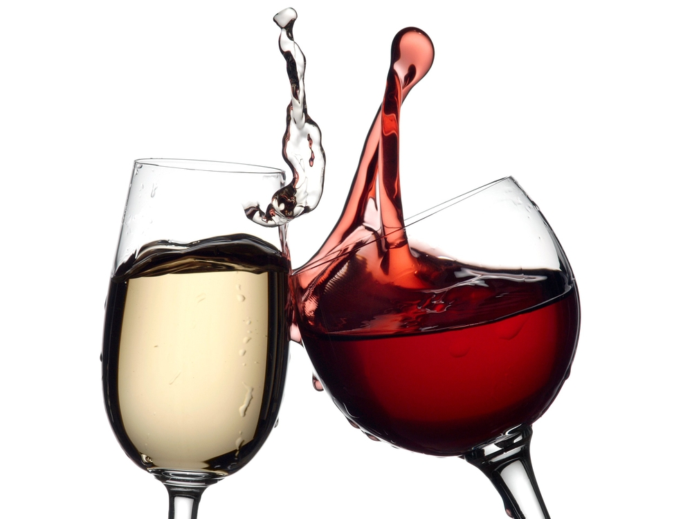
Cheers!!

